Slide 1
Tax Misclassification:
Lost Employment Benefits for Disabled Workers
March 6, 2025

Slide 2
The Bottom Line…
NCD identified outdated tax provisions still in effect that are incompatible with the evolution of modern disability employment policy.
These outdated tax provisions can be used in a way that creates employment barriers for people with disabilities, prevents them from attaining full employment status, and as a result, makes them ineligible to receive the full array of employment benefits and protections.

Slide 3
Impetus for NCD’s Investigation
Attorneys representing a blind employee at the Louisiana Association for the Blind in an Unemployment Appeal case contacted NCD.
On appeal, the Louisiana Workforce Comm. affirmed that the woman was not an employee entitled to unemployment benefits, as she was classified a “rehabilitation client” by the provider, rather than an employee.
This appeal decision left her ineligible for:
1. State unemployment benefits
2. The Enhanced Pandemic Unemployment benefits of $600/week
3. May have left her ineligible for EITC cash benefits from the IRS

Slide 4
Background: Payroll Matters
Specifically, “payroll” for tax purposes is key.
“Payroll records” for purposes of the U.S. Department of Labor (DOL) is not the same for purposes of the Internal Revenue Service (IRS)
If you are not on the employer’s payroll for tax/IRS purposes, you may be ineligible for employment benefits governed by the tax code and ERISA(*).
Revenue Ruling 65-165 may be used intentionally / unintentionally to keep some people with disabilities off of the payroll for employment tax purposes.

Slide 5
Background: Revenue Ruling 65-165
Created in 1965 to resolve the question of whether people with disabilities in sheltered workshop are employees for federal employment tax purposes
Used to determine employment status for PWD for FICA and FUTA purposes
Allows sheltered workshops to classify people with disabilities as one of three statuses:
CLIENT / REHABILITATION CLIENT – PWD is not an employee when given orientation and training in a sheltered workshop as part of a rehabilitation program designed to prepare them for placement in private industry. No employment relationship and trainees are not eligible for benefits given to employees.
EMPLOYEE - After completing training and becoming capable of performing a job offered in the workshop, the PWD can work in the workshop temporarily while awaiting placement in private industry, or permanently if unable to compete in regular industry. Working conditions must be comparable to those in private industry, meaning that the worker can be discharged if work is not satisfactory. An employment relationship is intended, and the workers are eligible for employee benefits.
INDEPENDENT CONTRACTOR – When an individual is incapable of working in the workshop, but able to produce salable goods, the workshop provides the materials which may be produced at the individual’s home, delivers the materials, provides instructions, and pays for completed articles which the individuals wishes to sell. Individuals may work when they please without being bound by production schedules and may sell the articles wherever they please. Under this fact pattern, no employment relation is intended.

Slide 6
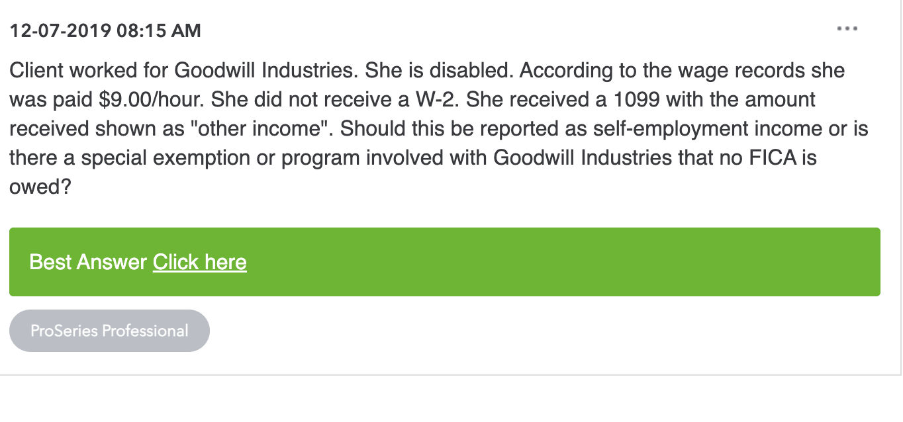
NCD FOUND EXAMPLES

Slide 7
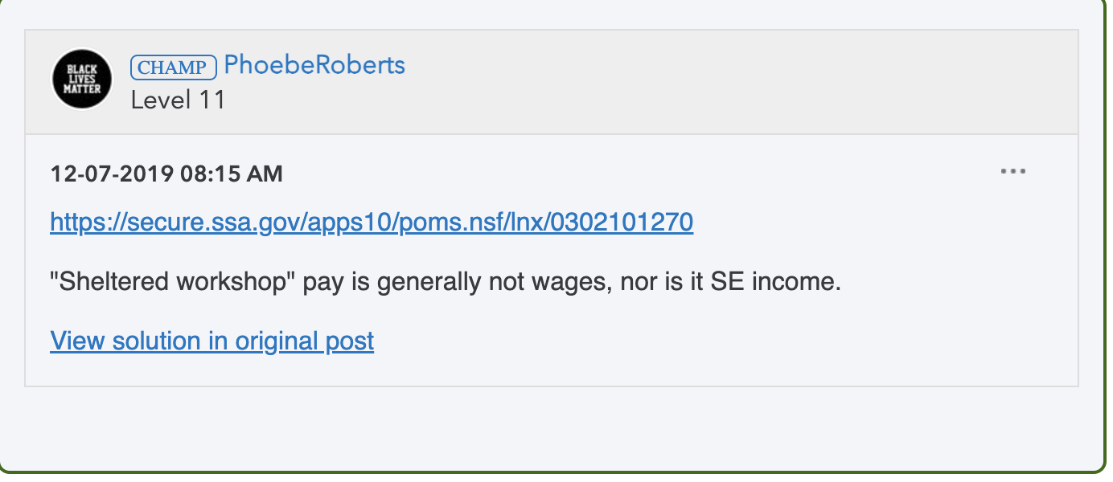
NCD FOUND EXAMPLES

Slide 8
These Workers Are Missing Out!
FLSA “employee” benefits
Minimum wage
Overtime
Tax “employee” benefits
FLSA benefits listed above
Paying into / earning credits towards Social Security Retirement (OASDI) eligibility
Paying into / earning credits toward Medicare benefits in retirement
ERISA benefits – tax deductible employer benefits plans including:
a. Health plans: Medical, dental, vision, prescription drug, and health flexible spending accounts (FSAs)
b. Retirement plans: Pension plans, 401(k)s, 403(b)s, and deferred compensation plans
c. Life insurance: Group life insurance and accidental death and dismemberment benefits
d. Disability benefits: Long-term disability insurance and insured disability income plans
e. Wellness programs: Wellness programs, disease management programs, and employee assistance programs (EAPs)
d. Funded vacation benefits, funded apprenticeship benefits, scholarship funds, prepaid legal services, and holiday or severance pay

Slide 9
Stark Contrast
“Rehab Client” for tax purposes
Likely receive an IRS Form 1099
Compensation received is not be “wages” but rather “incentives” or “awards”
You may be responsible for a 15.3% payroll tax liability on top of your income tax liability because your employer didn’t withhold taxes on your behalf.
May still be eligible for some employment benefits like minimum wage and overtime offered under the FLSA (if you are classified as a FLSA employee)
“Employee” for tax purposes
Will receive a W-2
Compensation paid to you is “wages”
Employer pays 6.2% for SS and 1.45% for Medicare on your behalf (FICA).
Paying into / earning credits for SS Retirement (OASDI) eligibility and Medicare benefits in retirement
ERISA benefits – tax deductible employer-sponsored benefits
a. Health plans: Medical, dental, vision, Rx, FSA, etc.
b. Retirement plans: Pension plans, 401(k)s, 403(b)s, etc.
c. Group life insurance, accidental death, etc.
d. Disability benefits: Long-term disability insurance, etc.
e. Wellness, disease management, and employee assistance programs
d. Other benefits: Paid vacation, apprenticeships, scholarships

Slide 10
Reminder:
ERISA also prohibits discrimination in health plan coverage based on an individual's health status.

Slide 11
You may be missing out on cash benefits through the IRS
Misclassifying people with disabilities -- or their compensation -- may leave them indelible for cash benefits.
The IRS offers the largest anti-poverty programs in the nation in the form of direct cash assistance paid to low-income taxpayers.

Slide 12
Prevalence of Misclassification is Unknown
A payroll audit of employers’ tax records is the only way to determine the full extent of worker misclassification.
Tax surveys are subjective and may only help determine if there is confusion about tax issues.
The CEOs of sheltered workshops may not be aware that misclassification is occurring since tax records are usually handled by their tax attorneys and CPAs.

Slide 13
NCD Recommendations
The IRS should revoke Revenue Ruling 65-165.
Congress should repeal provisions of the IRC like 26 U.S.C. § 3309(b)(4)) governing FUTA which can exempt wages paid to PWD in sheltered workers from the unemployment tax.
States that have adopted identical or similar exemptions like 26 U.S.C. § 3309(b) should repeal their unemployment exemption for PWD, which can leave PWD ineligible for unemployment benefits just like the Louisiana employee mentioned at the start:
Alabama, Connecticut, Delaware, District of Columbia, Illinois, Louisiana*, Missouri, Montana, New York, Oklahoma, South Carolina, Virginia, Virgin Islands, and Wisconsin.

Slide 14
How to fix the problem:
Incorporate modern disability policy into the IRC
Within 90 days of this report, the IRS Commissioner should convene an interagency workgroup to identify other outdated tax provisions and their impact on employment as well as other government benefits.
The IRS should create a disability advisory council within its agency to help the IRS understand ongoing and emerging issues critical to people with disabilities.

Slide 15
Impetus for NCD’s Investigation
Attorneys representing a blind employee at the Louisiana Association for the Blind in an Unemployment Appeal case contacted NCD.
On appeal, the Louisiana Workforce Comm. affirmed that the woman was not an employee entitled to unemployment benefits, as she was classified a “rehabilitation client” by the provider, rather than an employee.
This appeal decision left her ineligible for:
1. State unemployment benefits
2. The Enhanced Pandemic Unemployment benefits of $600/week
3. May have left her ineligible for EITC cash benefits from the IRS

Slide 16
TAX HEISTENCY
NCD found people with disabilities were misinformed or unaware that federal law excludes tax refunds as income and as a resource for 12 months. 26 USC § 6409

Slide 17
Tax matters for people with disabilities
Francine J. Lipman, William S. Boyd Professor of Law, University of Nevada, Las Vegas

Slide 18
THE earned income tax credit
Filing status, income, and family size determine the amount of the EITC.
The income amounts and the amount of EITC are adjusted for inflation.
If filing... | Earned Income & Adjusted Gross Income Must Be Less Than # of Qualifying Children Claimed (2025 tax year)
 | Zero Max $649 | One $4,328 | Two $7,152 | Three or more $8,046
Single, Head of Household or Widowed | $19,104 | $50,434 | $57,310 | $61,555
Married Filing Jointly | $26,214 | $57,564 | $64,430 | $68,675

Slide 19
THE CHILD TAX CREDIT (CTC)
Maximum amount of credit is $2,000 per “qualifying child”
Must have earned income to qualify for any amount of CTC
The credit amount is partially refundable up to the greater of 15% of earned income above $2,500 or $1,700 (indexed for inflation)
This Photo by Unknown Author is licensed under CC BY-SA

Slide 20
HOW DO I QUALIFY?
“QUALIFYING CHILD”
AGE: Child must have been under 17 at the end of year
RELATIONSHIP: Son, daughter, stepchild, adopted child, foster child, brother, sister, stepbrother, stepsister, half brother, half sister or descendant of any of these persons (e.g., grandchild, great grandchild, etc.)
DEPENDENT: You must claim the child as a dependent on your tax return
CITIZENSHIP: The child must be a U.S. citizen, U.S. national, or U.S. resident alien with a Social Security number.
RESIDENCE: Child must have lived with you for >1/2 yr

Slide 21
2025 example
FACTS:
EARNED INCOME: $10,000
FILING STATUS: Single
FEDERAL INCOME TAX OWED:
The family has $0 federal income tax liability, but $1,413 of payroll taxes.
Gross Income: $10,000
Less Standard Deduction: (15,000)
Taxable Income $0
Tax Credits:
EITC ( 650)
$650 TAX Refund Amount

Slide 22
2025 example
FACTS:
EARNED INCOME: $22,500
FILING STATUS: Unmarried individual with one qualifying child; Head of Household filing status
FEDERAL INCOME TAX OWED:
The family has $0 federal income tax liability, but $3,180 of payroll taxes.
Gross Income: $22,500
Less Standard Deduction: (22,500)
Taxable Income $0
Tax Credits:
Child Tax Credit ($1,700) Limited bc partially refundable
EITC ( 4,300)
$6,000 TAX Refund Amount

Slide 23
2025 example
FACTS:
EARNED INCOME: $33,200
FILING STATUS: Married Filing Jointly blind couple with 2 qualifying children
FEDERAL INCOME TAX OWED:
The family has $0 federal income tax liability, but $4,691 of payroll taxes.
Gross Income: $33,200
Less Standard Deduction: (33,200) additional amount bc both blind
Taxable Income $0
Tax Credits:
Child Tax Credit ($1,700) Limited bc partially refundable
EITC ( 3,750)
$5,450 TAX Refund Amount

Slide 24
https://www.irs.gov/pub/irs-pdf/p3966.pdf

Slide 25
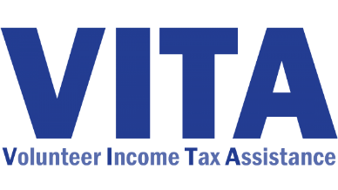
Help is Available!
VITA Sites:
The IRS's Volunteer Income Tax Assistance (VITA) program offers free basic tax return preparation to qualified individuals..
VITA sites offer free tax help to people who need assistance in preparing their own tax returns, including: people who generally make $67,000 or less; persons with disabilities; and Limited English-speaking taxpayers
Find a VITA site near you using the VITA Locator Tool:
https://irs.treasury.gov/freetaxprep/

Slide 26
New Direct File Tool
FR
Available in 24 states:
Alaska, Arizona, California
Connecticut, Florida, Idaho
Kansas, Maine, Massachusetts
Nevada, New Hampshire, New Jersey
New York, New Mexico, North Carolina
Oregon, Pennsylvania, South Dakota
Tennessee, Texas, Washington state
Wisconsin, Wyoming
Self-employed taxpayers cannot use Direct File
Cannot claim Educational Tax Credits
In English + Spanish
Child Tax Credit, EITC, & Other Dependent
Social Security & Interest Income
https://directfile.irs.gov/

Slide 27
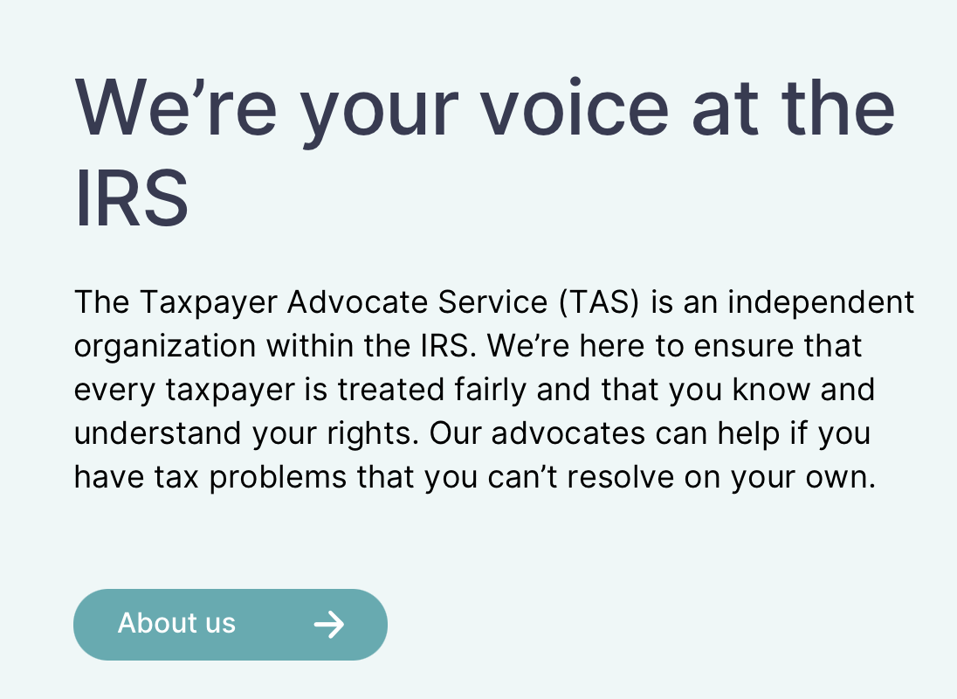
Taxpayer Advocate Service (TAS)
Congress created the Office of the National Taxpayer Advocate in 1998. The law also provides Local Taxpayer Advocates in each state, the District of Columbia, and Puerto Rico.
TAS serves taxpayers who need help with IRS tax matters and protects taxpayer rights.
TAS is Your Voice at the IRS. Contact your local TAS office.

Slide 28
Resources
FREE FILE at IRS.gov:
https://www.irs.gov/filing/free-file-do-your-federal-taxes-for-free
Electronically file (free resources available)
Electronically pay any tax due
Direct deposit your refunds
VITA (Volunteer Income Tax Assistance) Sites
VITA SITES: https://irs.treasury.gov/freetaxprep
VITA sites offer free tax help to people who need assistance in preparing tax returns, including:
People who generally make $67,000 or less
Persons with disabilities; and
Limited English-speaking taxpayers
Low-Income Taxpayer Clinics (LITCs) in Most States and D.C.
https://www.taxpayeradvocate.irs.gov/about-us/low-income-taxpayer-clinics-litc/
Scroll down to the “Need legal help with a tax issue?
Find your local clinic” section. Services are provided for free or for a small fee.

Slide 29
Tips for using a paid preparer
If you use a paid preparer, make sure to check out IRS website for resources https://irs.treasury.gov/rpo/rpo.jsf and be sure they:
give you a copy and
sign your return.
Review the return before it is filed to make sure there are no errors or names that you don’t recognize as a dependent or other
Open mail
Secure an online account with IRS

Slide 30
Contact Information
Francine J. Lipman
William S. Boyd Professor of Law
University of Nevada, Las Vegas
Francine.Lipman@unlv.edu
@narfnampil

Slide 31
Thank you!
Questions:
Kimie Eacobacci Legislative Affairs Specialist keacobacci@ncd.gov

